Slide 1


Muhammad Zimran Khalid
30th September, 2023

Slide 2

Outline
Executive Summary
Introduction
Methodology
Results
Conclusion
Appendix

Slide 3
Executive Summary
Summary of methodologies
Collect data using SpaceX REST API and web scraping techniques
Wrangle data to create success/fail outcome variable
Explore data with data visualization techniques
Analyze the data with SQL
Explore launch site success rates and proximity to geographical markers
Visualize the launch sites with the most success and successful payload ranges
Build Models to predict landing outcomes using logistic regression, support vector machine (SVM), decision tree and K-nearest neighbor (KNN)
Summary of all results
Launch success has improved over time
KSC LC-39A has the highest success rate among landing sites
Orbits ES-L1, GEO, HEO, and SSO have a 100% success rate
All models performed similarly on the test set. The decision tree model slightly outperformed

Slide 4
Introduction
SpaceX strives to make space travel affordable for everyone.
SpaceX can do this economically ($62 million per launch) due to its novel reuse of the first stage of its Falcon 9 rocket, as compared to its competitors, who are not able to reuse the first stage, cost upwards of $165 million each.
By determining if the first stage will land, we can determine the price of the launch.
Explore
How payload mass, launch site, number of flights, and orbits affect first-stage landing success
Rate of successful landings over time
Best predictive model for successful landing of first stage

Slide 5

Section 1

Slide 6
Methodology
Executive Summary
Data collection: Using SpaceX REST API and web scraping techniques
Wrangle Data: Filtering the data, handling missing values and applying one hot encoding – to prepare the data for analysis and modeling
Perform exploratory data analysis (EDA) using visualization and SQL
Perform interactive visual analytics using Folium and Plotly Dash
Perform predictive analysis using classification models
To predict landing outcomes using classification models. Tune and evaluate models to find best model and parameters

Slide 7
Data Collection
The data collection stage is the most crucial stage in the project. Two methods were used to collect data:
SpaceX API request.
Web Scraping

Slide 8
Data Collection – Scraping
Acquired historical launch data from Wikipedia page 'List of Falcon 9 and Falcon Heavy Launches'
Requested the Falcon9 Launch Wiki page from its Wikipedia URL
Created a beautiful soup object
Found all tables.
Extracted all column/variable names from the HTML table header
Converted Dictionary to Dataframe
Saved in a Dictionary
Appended Data to Keys
Saved Dataframe into
.csv file
URL: Web Scrapping

Slide 9
Data Collection – SpaceX API
Requested rocket launch data from SpaceX API
Requested and parsed
SpaceX data with GET request
Decoded response as a .json file
Turned it into Pandas dataframe
Used the API with functions to get info from IDs: (BoosterVersion, Payloads, LaunchSite, Cores)
Stored in List
Selected Falcon9 data only
Replaced missing payload mass value with mean
Assigned list to dictionary Converted to Dataframe
Saved Dataframe into
.csv ile
URL: Data Collection

Slide 10
Data Wrangling
Calculate the number and occurrences of each orbit
Determine the number of launches on each facility
Calculate the number and occurrences of mission outcome per orbit type
Create a "Class" column containing the information from the outcome label
Create a landing outcome training label and loop through all the landing outcomes
Transform the data frame into a CSV dataset
URL: Data Wrangling

Slide 11
EDA with Data Visualization
Graphs and scatter charts with Matplotlib – Seaborn and Analysis.
Results with Scatter charts are labeled: class 0-1 (failure/success).
Payload mass & Flight Number
Launch Site & Flight number
Launch Site & Payload mass
Orbit & Flight number
Orbit & Payload mass
Histogram: success rate for each orbit
Falcon 9 & Ariane-5 launch success yearly trend.
URL: Data Visualization

Slide 12
EDA with SQL
Summary of SQL queries:
Display the names of the unique launch sites in the space mission
Compare the payload mass with boosters launched by NASA (CRS)
Display average payload mass carried by booster version F9 v1.1
List the total number of successful and failure mission outcomes
Determine the dates of different landing outcomes
URL: EDA SQL

Slide 13
Build an Interactive Map with Folium
Folium Markers were used to show the SpaceX launch sites and their nearest important landmarks like railways, highways, cities and coastlines.
Polylines were used to connect the launch sites to their nearest land marks.
Folium Circles were used to highlight circle area of launch sites.
In order to mark the success/failed launches for each site, marker clusters were used on the map. Red represents rocket launch failures while Green represents the successes.
URL: Folium

Slide 14
Build a Dashboard with Plotly Dash
Dropdown List with Launch Sites: Allow user to select all launch sites or a certain launch site
Slider of Payload Mass Range: Allow user to select payload mass range
Pie Chart Showing Successful Launches: Allow user to see successful and unsuccessful launches as a percent of the total
Scatter Chart Showing Payload Mass vs. Success Rate by Booster Version: Allow user to see the correlation between Payload and Launch Success
URL: Dashboard

Slide 15
Predictive Analysis (Classification)
Create NumPy array from the Class column
Standardize the data with StandardScaler. Fit and transform the data.
Split the data using train_test_split
Create a GridSearchCV object with cv=10 for parameter optimization
Apply GridSearchCV on different algorithms: logistic regression, support vector machine (SVC()), decision tree, K-Nearest Neighbor
Calculate accuracy on the test data using .score() for all models
Assess the confusion matrix for all models
Identify the best model using Jaccard_Score, F1_Score and Accuracy
URL: Classification

Slide 16
Results
Exploratory Data Analysis
Launch success has improved over time
KSC LC-39A has the highest success rate among landing sites
Orbits ES-L1, GEO, HEO and SSO have a 100% success rate
Visual Analytics
Most launch sites are near the equator, and all are close to the coast
Launch sites are far enough away from anything a failed launch can damage (city, highway, railway), while still close enough to bring people and material to support launch activities
Predictive Analytics
Decision Tree model is the best predictive model for the dataset

Slide 17

Section 2

Slide 18
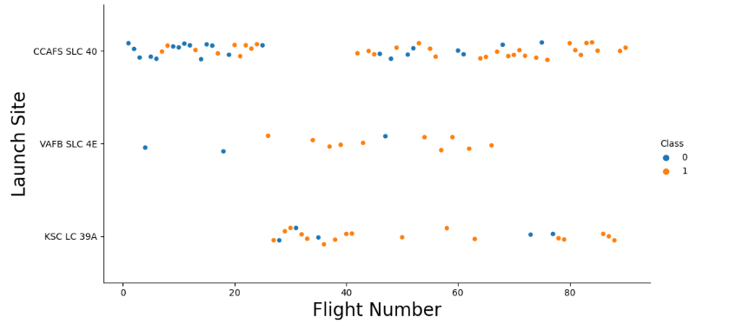
Flight Number vs. Launch Site
Around half of launches were from CCAFS SLC 40 launch site
VAFB SLC 4E and KSC LC 39A have higher success rates
New launches have a higher success rate

Slide 19
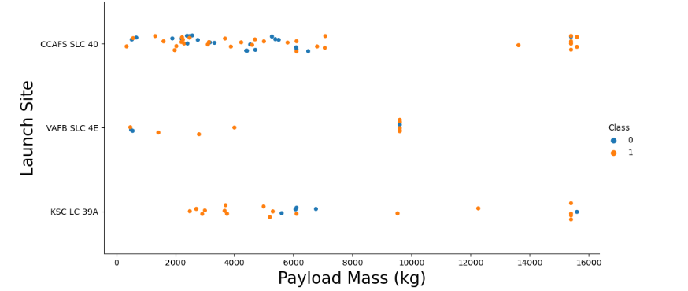
Payload vs. Launch Site
Most launces with a payload greater than 7,000 kg were successful
KSC LC 39A has a 100% success rate for launches less than 5,500 kg
VAFB SKC 4E has not launched anything greater than ~10,000 kg

Slide 20
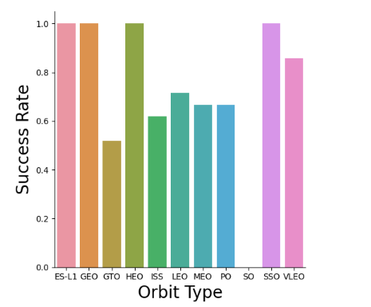
Success Rate vs. Orbit Type
100% Success Rate: ES-L1, GEO, HEO and SSO
50%-80% Success Rate: GTO, ISS, LEO, MEO, PO
0% Success Rate: SO

Slide 21
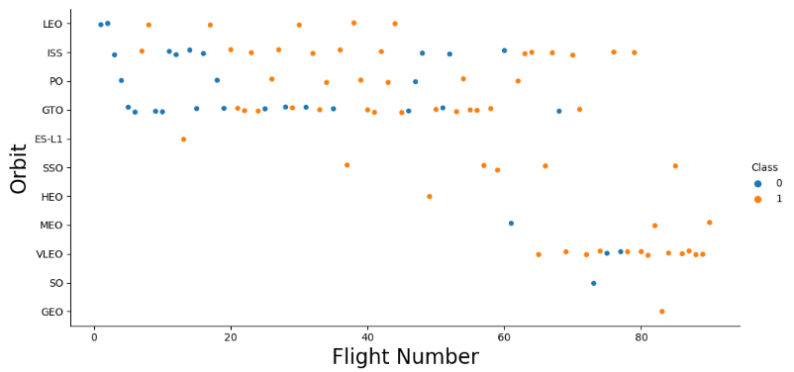
Flight Number vs. Orbit Type
The success rate increases with the number of flights for each orbit
This relationship is highly apparent for the LEO orbit
• The GTO orbit does not follow this trend

Slide 22
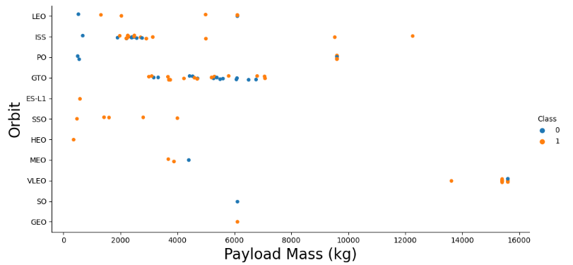
Payload vs. Orbit Type
Heavy payloads are better with LEO, ISS and PO orbits
GTO orbit has mixed success with heavier payloads

Slide 23
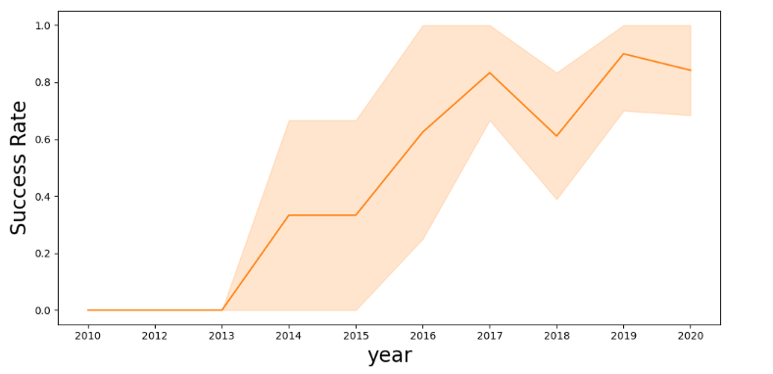
Launch Success Yearly Trend
The success rate improved from 2013-2017 and 2018-2019
The success rate decreased from 2017-2018 and from 2019-2020
Overall, the success rate has improved since 2013

Slide 24
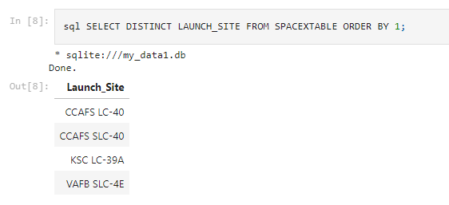
All Launch Site Names
CCAFS LC-40
CCAFS SLC-40
KSC LC-39A
VAFB SLC-4E

Slide 25
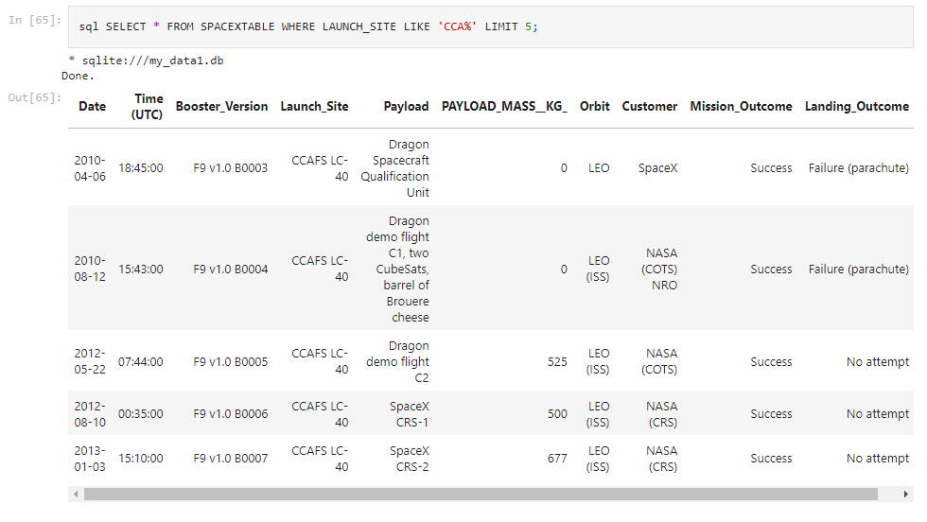
Launch Site Names Begin with 'CCA'

Slide 26
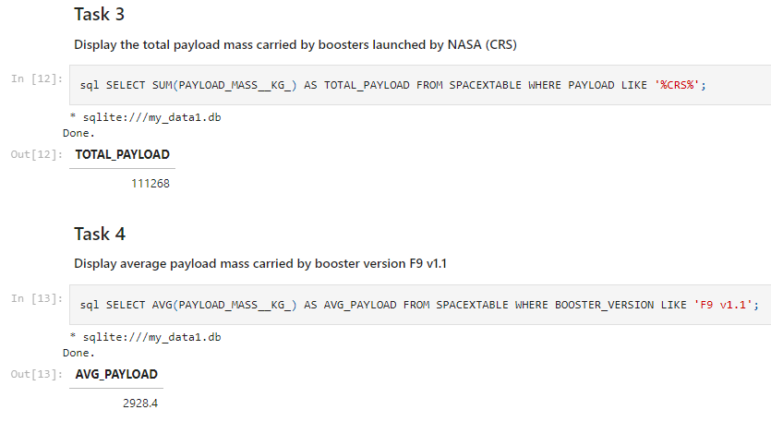
Total Payload Mass
111,268 kg (total) carried by boosters launched by NASA

Slide 27
Average Payload Mass by F9 v1.1
2,928.4 kg (average) carried by booster version F9 v1.1

Slide 28
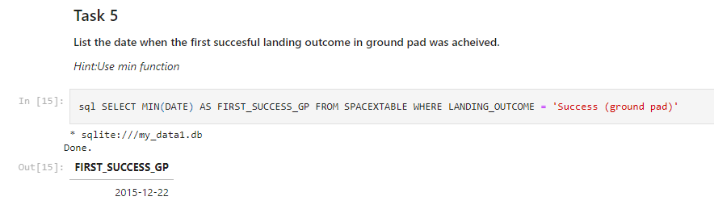
First Successful Ground Landing Date
1st Successful Landing in Ground Pad: 12/22/2015

Slide 29
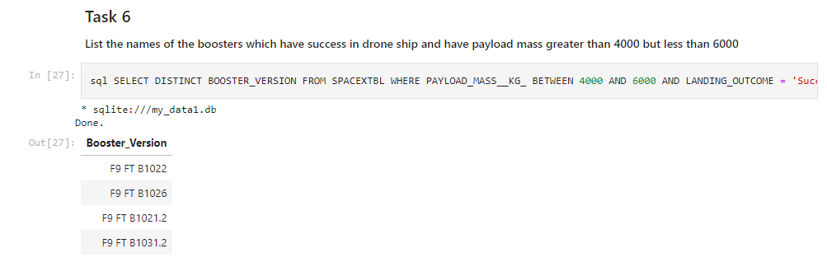
Successful Drone Ship Landing with Payload between 4000 and 6000
Booster mass greater than 4,000 but less than 6,000

Slide 30
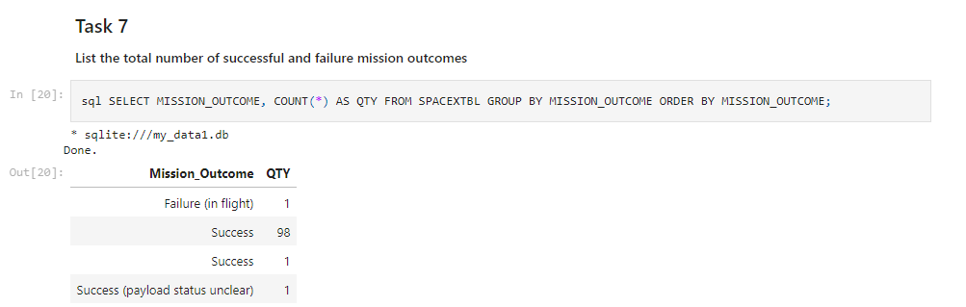
Total Number of Successful and Failure Mission Outcomes
1 Failure in Flight, 99 Success, 1 Success (payload status unclear)

Slide 31
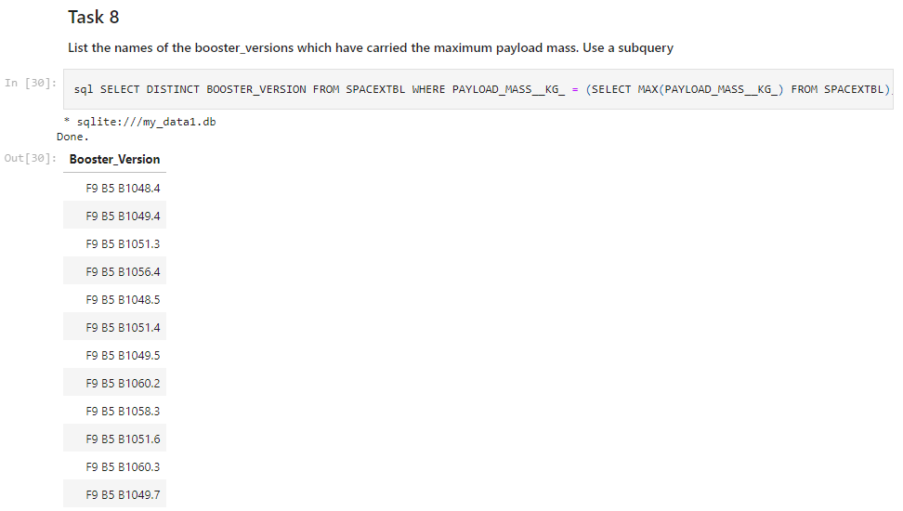
Boosters Carried Maximum Payload

Slide 32
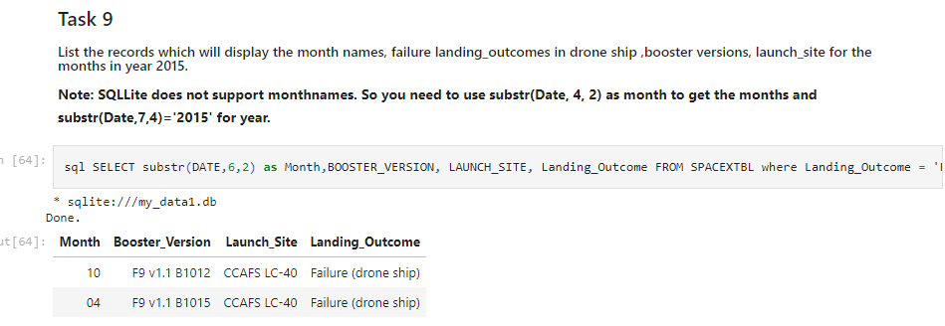
2015 Launch Records

Slide 33
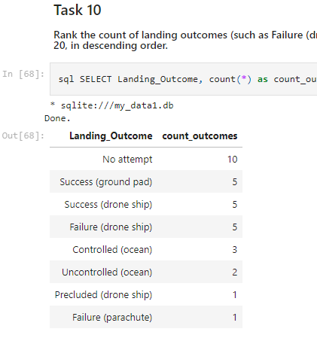
Rank Landing Outcomes Between 2010-06-04 and 2017-03-20

Slide 34

Section 3

Slide 35
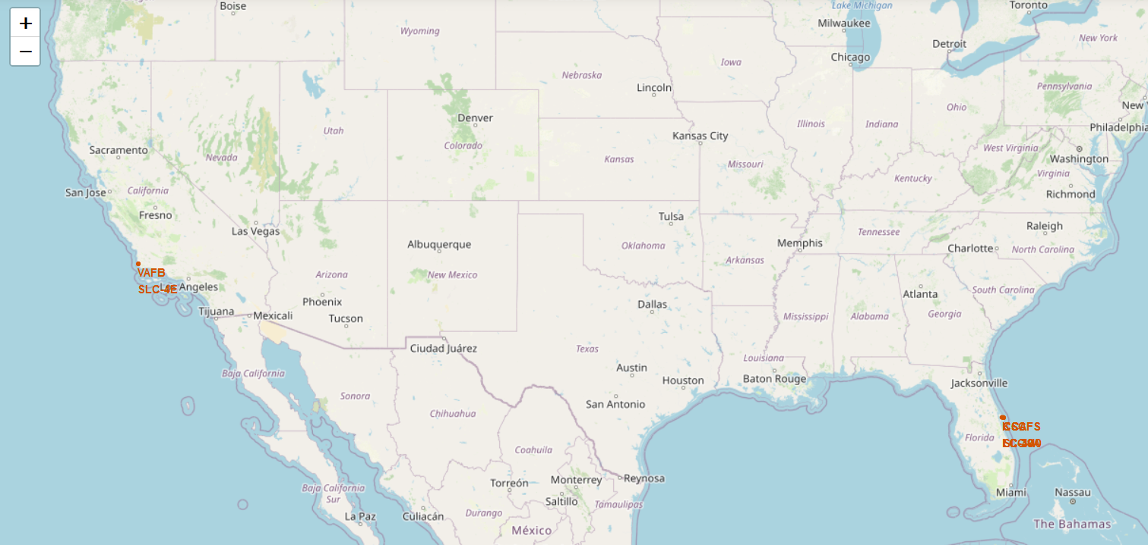
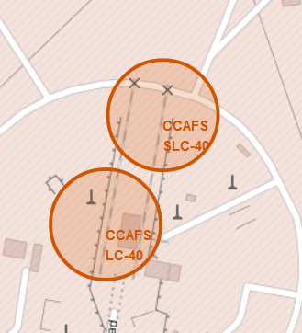
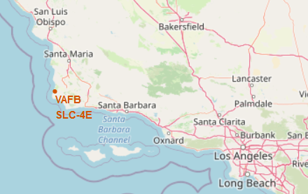
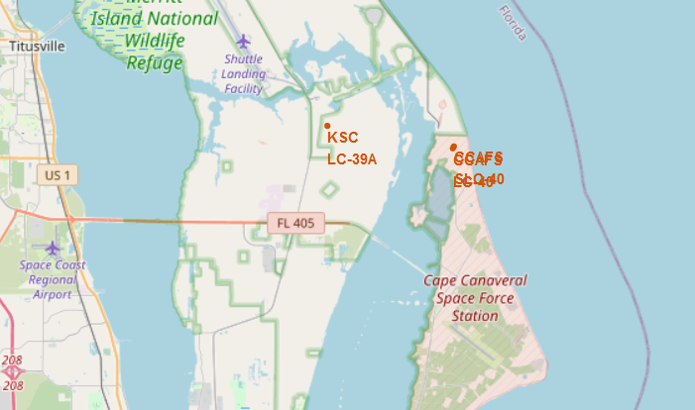
SpaceX: All launch sites
VAFB SLC-4E: Vandenberg Space Launch Complex 4 (CA)
KSC-LC29A: Kennedy Space Center - Merritt Island (FL)
CCAFS-LC40: Cape Canaveral Launch Complex 40 (FL)
CCAF-SLC40: Cape Canaveral Space Launch Complex 40(FL)

Slide 36
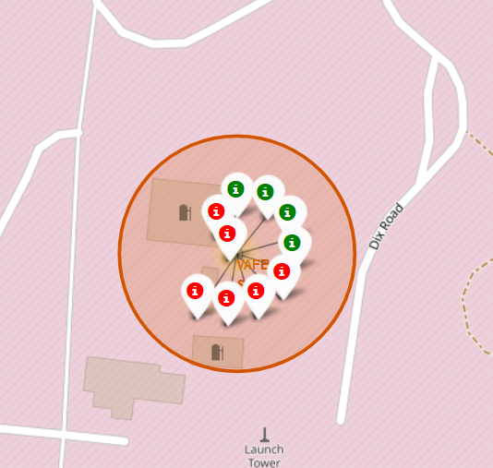
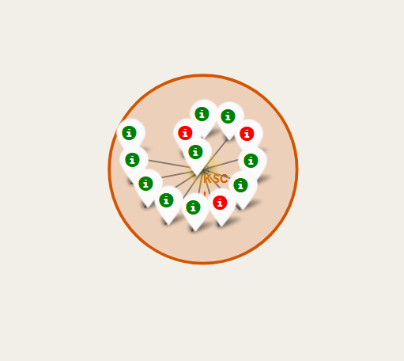
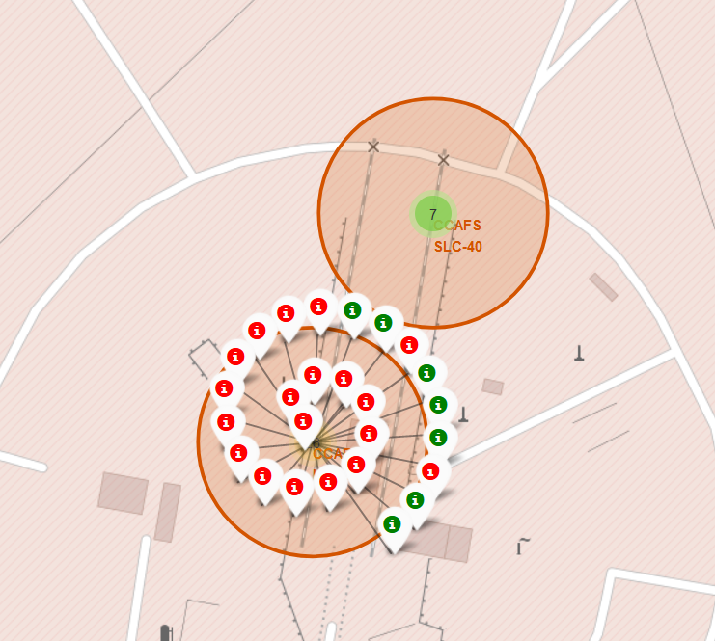
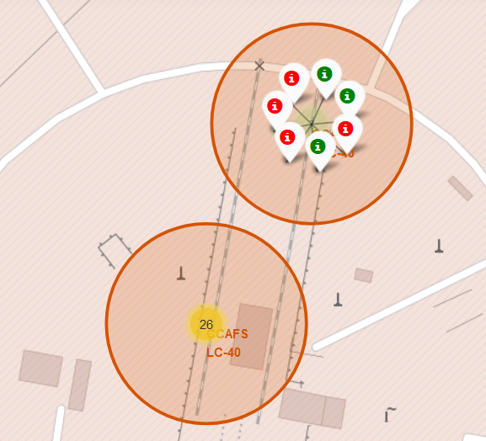
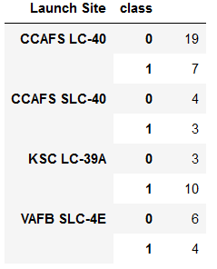
Falcon 9 Success/Failed launches for each site
Vandenberg Space Launch Complex 4 (CA)
VAFB SLC-4E
Kennedy Space Center (FL)
KSC LC 39A
Cape Canaveral (FL)
CCAFS-LC40
Cape Canaveral (FL)
CCAFS-SLC40
Table: Synthesis of launches outcomes
Class 0= failure
Class 1= success

Slide 37
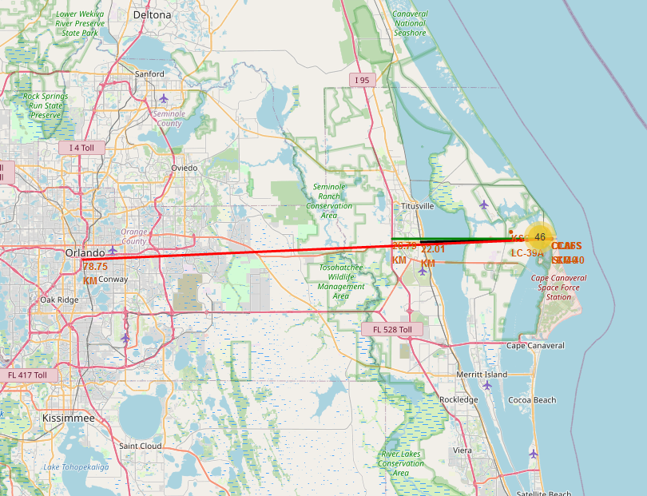
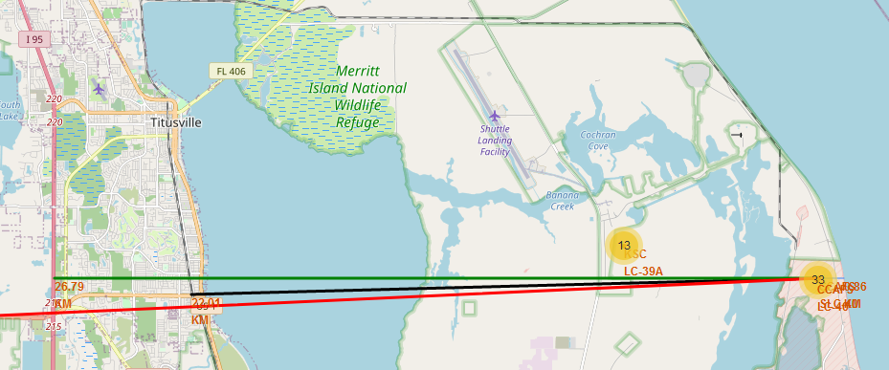
Distances between a launch site to its proximities
Distance from CCAFS_SLC40 to:
Closest coast: ~900 m
Florida East Coast Railway: 22.0 km
Highway I 95: 26.8 km
Orlando: 78.75 km
Launch sites are close to coasts. For safety issues if launcher is lost in the early stage of the flight.
Rockets are launched:
From West to East over the ocean in Florida.
North or South bound over the ocean in California. (Polar orbits only)
Launch sites are relatively far from populated areas for protecting population from serious incidents at lift off: explosion on the launch pad.

Slide 38

Section 4

Slide 39
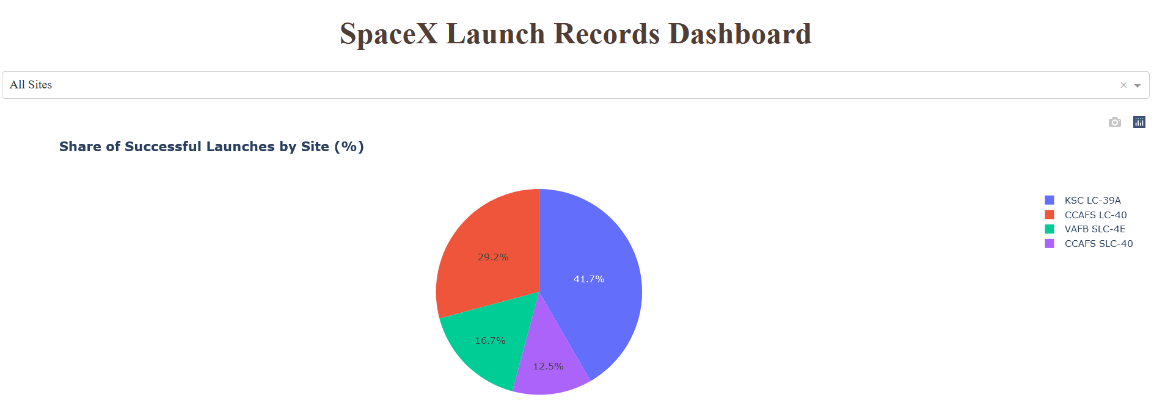
SpaceX Falcon 9: Launch success count for all sites
The dahsboard allows an interactive visualization and analysis of Falcon successful launches.
It completes scattered charts.
KSC LC-39A had the most successful launches from all the sites

Slide 40
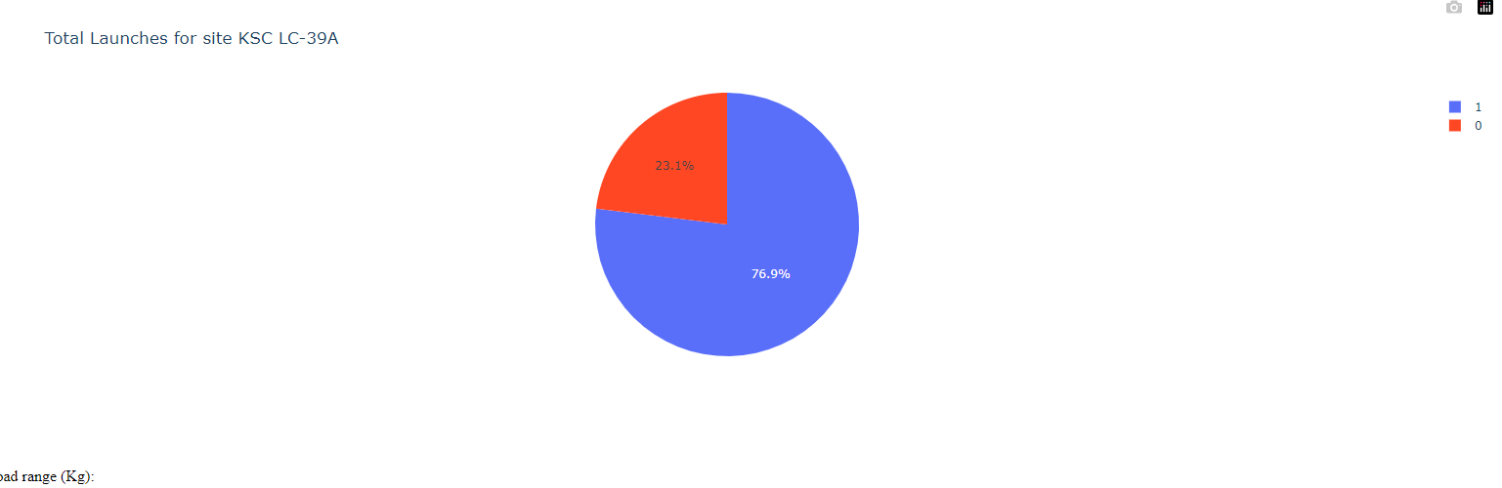
DASHBOARD – Launch site with highest launch success ratio
KSC LC-39A achieved a 76.9% success rate while getting a 23.1% failure rate

Slide 41
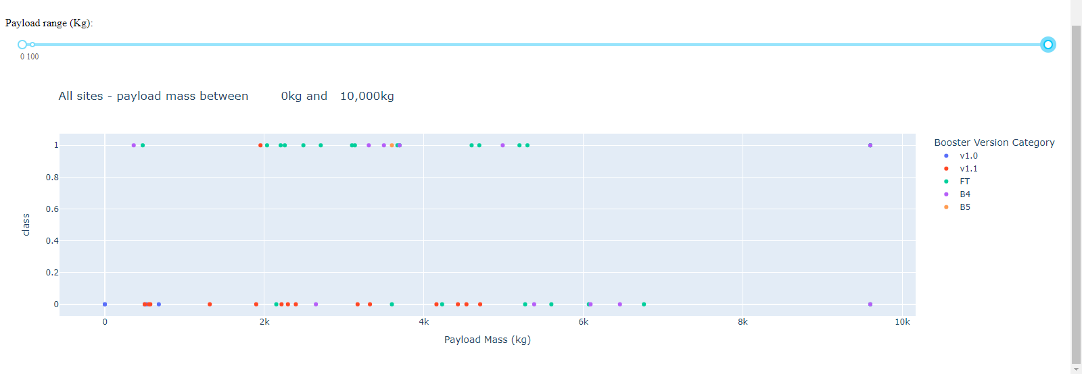
Payload vs. Launch Outcome for all sites
We can see the success rates for low weighted payloads is higher than the heavy weighted payloads

Slide 42

Section 5

Slide 43
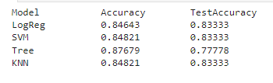
Classification Accuracy
Tree exhibits the best accuracy: ~87%

Slide 44
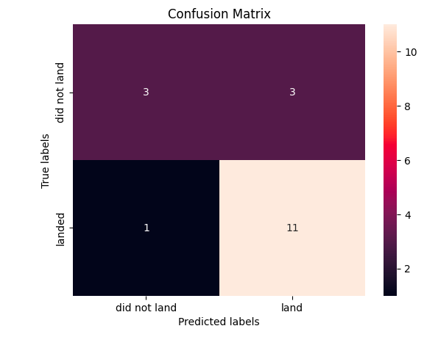
Confusion Matrix
Examining the confusion matrix, we can see that Tree can distinguish between the different classes.

Slide 45
Conclusions
The Tree Classifier Algorithm is the best for Machine Learning for this dataset
Low weighted payloads perform better than the heavier payloads
The success rates for SpaceX launches is directly proportional time in years they will eventually perfect the launches
KSC LC-39A had the most successful launches from all the sites
Orbit GEO,HEO,SSO,ES-L1 has the best Success Rate

Slide 46
Appendix
All Source Files - https://github.com/raysengr/IBM-data-science-capstone-project.git

Slide 47


